Slide 1
Human Computer Interaction (HCI)
The study of interaction between people (users) and computers focused on the design, evaluation and implementation of interactive computing systems for human use. It is an interdisciplinary subject, relating computer science with many other fields of study and research.
design
implementation
evaluation

Slide 2
Relationship between Usability and other fields
Academic disciplines contributing to Usability:
  Psychology
  Social Sciences
  Technology
  Engineering
  Ergonomics
  Informatics
  Designers / Writers/ Story telling

Slide 3
Relationship between Usability and other fields
Design practices contributing to Usability:
  Graphic design
  Product design
  Artist-design
  Industrial design
  Film industry

Slide 4
Usability Cousins
  Interaction design,
  User interface design,
  Software design,
  User-centered design,
  Product design,
  Web design,
  Experience design (UX)
  UX Design….

Slide 5
What is interaction design?
Designing interactive products to support the way people communicate and interact in their everyday and working lives
      Sharp, Rogers and Preece (2011)
The design of spaces for human communication and interaction
      Winograd (1997)

Slide 6
Goals of interaction design
Develop usable products
  Usability means easy to learn, effective to use and provide an enjoyable experience
Involve users in the design process

Slide 7
Usability Definition
Usability Goals
User Experience Goals
Usability Slogans
Usability Engineering
Usability Factors
Usability
Copyright © 2005, Pearson Education, Inc.

Slide 8
What is Usability
Usability is the extent to which a product can be used by it’s users to achieve specified goals with effectiveness, efficiency, and satisfaction in a specified context of use with a minimum of errors.

Slide 9
Usability
Useable systems lead to a competitive advantage, enhanced reputation, and loyal customers.
For users it leads to efficiency and increased productivity, job satisfaction, and improved quality of life.

Slide 10
The Reality
When a product is well designed, users don’t complain about it and probably don’t even compliment it – it’s expected.
When a product is confusing to use or is uncomfortable, you will always hear about it – either in customer complaints or lack of future sales!

Slide 11
The Problem
63% of large software projects go over cost
  managers gave four usability-related reasons
    users requested changes
    overlooked tasks
    users did not understand their own requirements
    insufficient user-developer communication and understanding
Usability Engineering is Software Engineering
  pay a little now, or pay a lot later!
  far too easy to jump into detailed design that is:
    founded on incorrect requirements
    has inappropriate dialogue flow
    is not easily used
    is never tested until it is too late

Slide 12
Usability Engineering
Usability Engineering is a process. (not one time affair, requirement)
It is a set of activities that take place throughout the lifecycle of the product
and it involves many things including 4 P’s
Cannot be seen in isolation.

Slide 13
Goals of Usability
Effectiveness
Efficiency
Satisfaction
Learnability
Intuitiveness
Helpfulness
Controllability
Avoiding excessive mental or physical load
Safety

Slide 14
User experience goals
Desirable aspects
satisfying helpful fun
enjoyable motivating provocative
engaging challenging surprising
pleasurable enhancing sociability rewarding
exciting supporting creativity emotionally fulfilling
entertaining cognitively stimulating
Undesirable aspects
boring unpleasant
frustrating patronizing
making one feel guilty making one feel stupid
annoying
childish gimmicky

Slide 15
Considerate Software
Some believe that software should behave like a considerate human. Considerate software:
  Takes an interest
  Is deferential
  Is forthcoming
  Uses common sense
  Anticipates needs
  Is conscientious
  Doesn’t burden you with it’s personal problems
  Keeps you informed
  Is perceptive
  Is self-confident
  Doesn’t ask a lot of questions
  Takes responsibility
  Knows when to bend the rules

Slide 16
Usability Benefits
Reduced training costs
Reduced support and service costs
Reduced error costs
Increased user productivity
Increased customer satisfaction
Increased maintainability

Slide 17
Usability Slogans
  Your best guess is not enough
    Understand the user and their task
    Validation
    Iterative
  The user is always right/not right
  Users are not designers
  Designers are not users (no temptation to follow your own intuitions)

Slide 18
Usability Slogans
  Vice President/ Senior Management are not designers
  Less is more
  7. Details Matter
  8. Help Does Matter

Slide 19
Usability – How do we get there?
Get user input early and often.
Human factors should be considered at every stage of the product life cycle.
Product usability is optimized when the user is the central focus of the product development process.
The user and context of use must be considered early in the product development cycle as requirements are being defined.

Slide 20
Usability – How do we get there?
Common sense, intuition, or appointing the design team as “users” is too limited and not sufficient.
The product development team must understand how, when, where, and why the product will be used by the users.
It is much easier, faster, and cheaper, to make revisions early in the design cycle rather than after the product is complete.

Slide 21
Usability Concerns
Who are the users?
In what context will the product be used?
What tasks will be performed?
What is the social, organizational, and physical environment?
When will the product be used?
Where will the product be used?
What are the locations’ characteristics?

Slide 22
Usability Engineering
Usability is all about how users interact with technology, and usability engineering studies the human-computer interface (HCI) in depth.
Usability engineering requires a firm knowledge of computer science and psychology and approaches product development based on customer feedback.

Slide 23
Usability Factors
Organisational Factors
  Training
  Work organisation hierarchy
  Roles and Authorities
  Politics
  Job design
  Work stations

Slide 24
Usability Factors (cont.)
The standard ANSI/HFES 100-2007 Human Factors Engineering of Computer Workstations (2007) lists these concerns:
  Work-surface and display-support height
  Clearance under work surface for legs
  Work-surface width and depth
  Adjustability of heights and angles for chairs and work surfaces
  Posture - seating depth and angle; back-rest height and lumbar support
  Availability of armrests, footrests, and palmrests
1-<number>

Slide 25
Usability Factors (cont.)
2. Environment and Comfort Factors
    Noise, Heating, Lighting, Ventilation
    Health and safety issues
    Seating Layout
    Screen-brightness preferences vary substantially, designers customarily provide a knob to enable user control
    Vision: depth, contrast, color blindness, and motion sensitivity
    Touch: keyboard and touchscreen sensitivity
    Hearing: audio clues must be distinct
    Workplace design can both help and hinder work performance

Slide 26
Usability Factors (cont.)
The Users
    The expert users, the novice user, different categories like disabled, elderly, women, young users, children
    Motivation, Enjoyment, satisfaction, personality, experience , cognitive abilities (reasoning, perception, memory, judgmental)
  Studies have also suggested a set of factors affecting perceptual and motor performance:
    Fatigue and sleep deprivation
    Perceptual (mental) load
    Knowledge of results and feedback
    Monotony and boredom
    Nutrition and diet
    Fear, anxiety, mood, and emotion
    Drugs, smoking, and alcohol
    Physiological rhythms

Slide 27
Usability Factors (cont.)
Cognitive and perceptual abilities
  The human ability to interpret sensory input rapidly and to initiate complex actions makes modern computer systems possible
  The journal Ergonomics Abstracts offers this classification of human cognitive processes:
    Long-term and semantic memory
    Short-term and working memory
    Problem solving and reasoning
    Decision making and risk assessment
    Language communication and comprehension
    Search, imagery, and sensory memory
    Learning, skill development, knowledge acquisition, and concept attainment

Slide 28
Usability factors (cont.)
4. User Interfaces
    Input device, output device, dialogue structure, use of color, icons, multimedia, AI, NLP
System Functionality and Productivity Factors
  Increase output, increase quality/profit , decrease cost, decrease errors.
Constraints
    Cost, timescale, budget, staff equipment

Slide 29
Usability factors (cont.)
7. Cultural and International diversity
  Characters, numerals, special characters
  Left-to-right versus right-to-left versus vertical input and reading
  Date and time formats
  Numeric and currency formats
  Weights and measures
  Telephone numbers and addresses
  Names and titles (Mr., Ms., Mme.)
  Social-security, national identification, and passport numbers
  Capitalization and punctuation
  Sorting sequences
  Icons, buttons, colors
  Pluralization, grammar, spelling
  Etiquette, policies, tone, formality, metaphors

Slide 30
Usability Engineering Lifecycle
Know the User
  Individual user Characteristics (age, education level, work experience, skill set, personal/social status)
  The user's current and desired tasks (task analysis.. normal task flow, task decomposition, notable successes and failures, best and least task, changes they desire, improvements ideas, pain points)
Copyright © 2005, Pearson Education, Inc.

Slide 31
Usability Engineering Lifecycle
Functional Analysis --- identify the functionality, how the system will work?
The evolution of the user
  chart out a plan as design should be flexible in nature to accommodate the changes (short cuts, extra functionality, new versions..)
Copyright © 2005, Pearson Education, Inc.

Slide 32
Usability Engineering Lifecycle
Competitive Analysis
Set Usability Goals
Financial Impact analysis /// performance / cost / Timeline / learnability/ scope
Parallel Design
  divide the team into sub groups and ask everyone to come with preliminary designs
Copyright © 2005, Pearson Education, Inc.

Slide 33
Usability Engineering Lifecycle
Participatory Design
  ask users participation,
  users are not designers so not reasonable to expect them to come up,
  but once options are there then they are good in giving their inputs,
  market analysis before going for a complete finalization
Copyright © 2005, Pearson Education, Inc.

Slide 34
Usability Engineering Lifecycle
Co-ordinated design of the total interface
Guidelines and Heuristic Evaluation
Prototyping
Empirical Testing
Capture Design Rational
Collect Feedback from actual users
Copyright © 2005, Pearson Education, Inc.

Slide 35
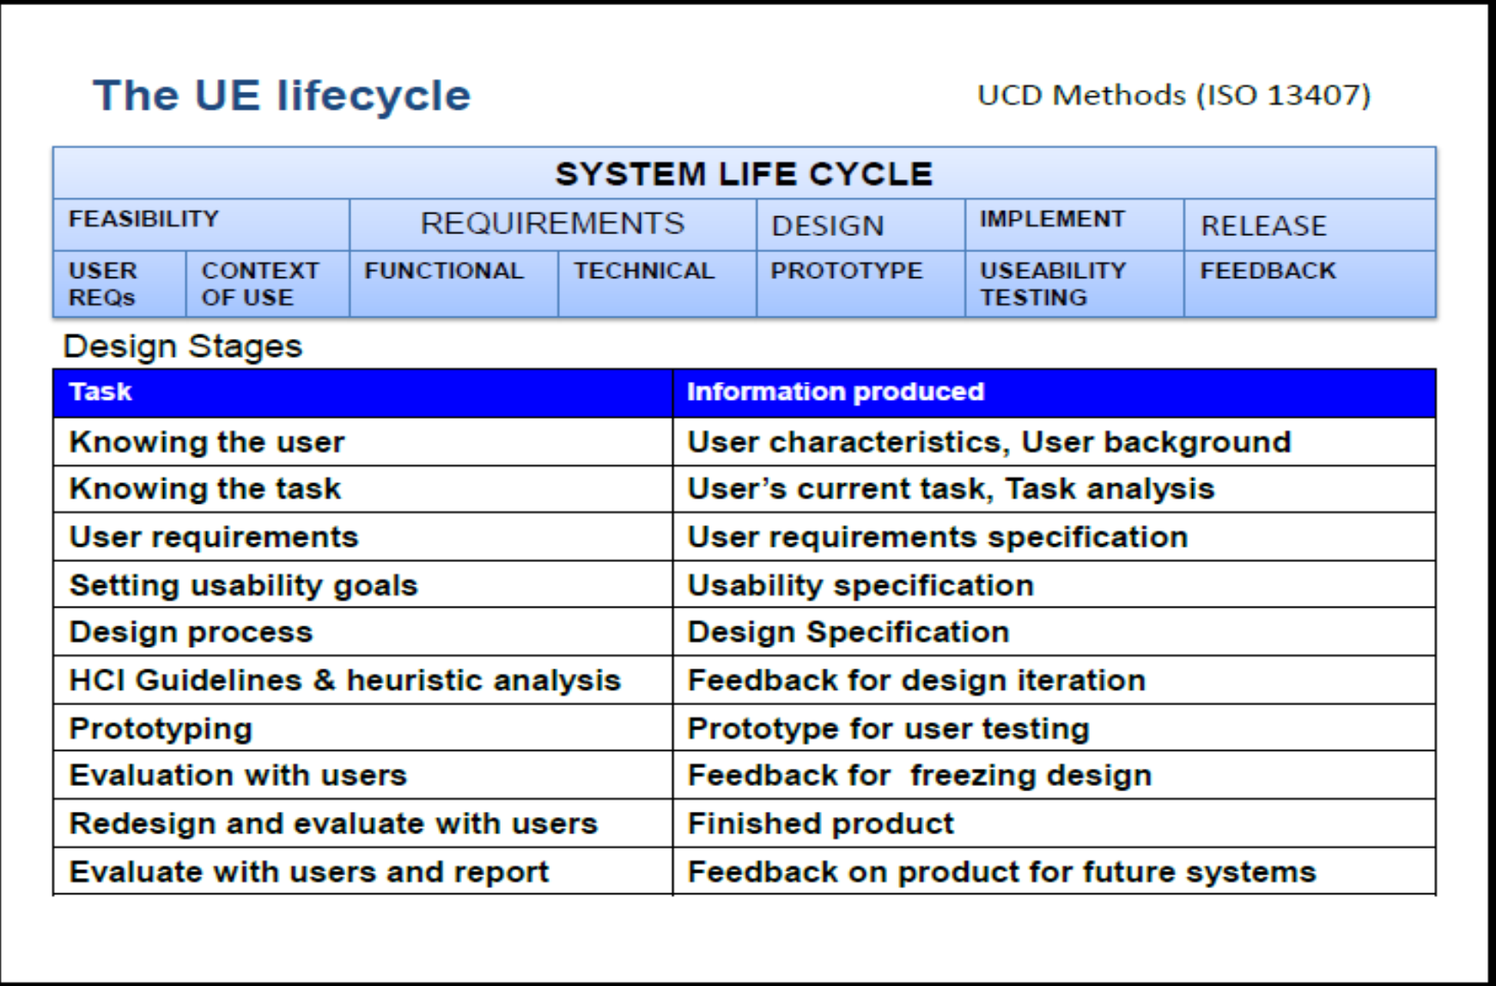
Usability Engineering Lifecycle
Copyright © 2005, Pearson Education, Inc.

